Slide 1
Electrical Components

Slide 2
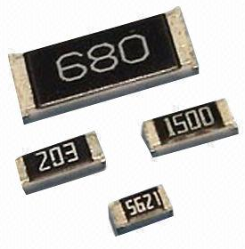
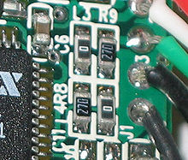
SMD Resistors
These are called “chip” resistors
Parameters
Resistance – in ohms
Size – how long and wide
Tolerance – in % accuracy of the Ohms rating
Watts – amount power they can safely dissipate

Slide 3
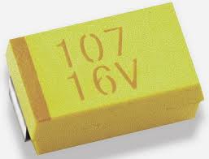
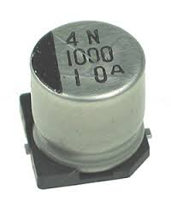
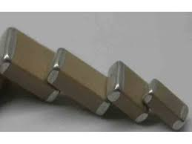
SMD Capacitors
These are called “chip” caps and resistors
Parameters
Capacitance – how much energy it holds
Voltage – Volts it can withstand
Polarized – yes or no
Discharge speed
Type
“Ceramic” – very fast
“Tantalum” – higher capacity

Slide 4
Resistor and Capacitor Sizes
High wattage resistors need to be large
We won’t need these
Large capacitance caps need to be large.
Might need these

Slide 5
SMD Parts We Have on Hand
0805 Caps and resistors (good choice) https://www.adafruit.com/products/441
Additional values are available
Resistors: http://goo.gl/q7Iv7R
Caps: http://goo.gl/p6hLXR
And some more in my lab.
Other resistors:
0603: http://www.digikey.com/product-detail/en/PHG2A-KIT/PHG2A-KIT-ND/383654
1206 (don’t have but could buy): http://www.digikey.com/product-detail/en/PHE2A-KIT/PHE2A-KIT-ND/383662
Other caps
0402-1206 Ceramic: http://www.digikey.com/product-detail/en/C-HC01-E3-KIT/445-9003-KIT-ND/3644796
Tantalum (various sizes: http://www.digikey.com/product-detail/en/TANTTAC001D/478-3450-ND/992232
0402 Ceramic:http://www.digikey.com/product-detail/en/DIGI-402/709-1109-ND/1859441
LEDs
0603: http://www.digikey.com/product-detail/en/511-8003-KIT/511-8003-KIT-ND/1777670

Slide 6
Through-hole Parts We Have
We have these kits available. You can search for the part number on digikey to find out more
Diodes: DIODESKITFS-ND
Schottky diodes: 497-8006A-KIT-ND
Caps: NHG2-KIT-ND
Big caps: P4542-KIT-ND
Resistors: RS112-ND

Slide 7
Part Selection
There are many choices for electronic components
For common parts (resistors, caps, etc.) there’s a page on the wiki that says which ones to use, if possible
For less common parts, you may have to find you own
Look on digikey
Look on Adafruit and sparkfun
Google around for information about design considerations
Pour over datasheets
Bonus points if there’s a through-hole and surface mount version

Slide 8
Digikey Demo
Let’s find some LEDs

